Slide 1

Amazon Sales Dashboard Dynamic Visualization of Sales and Profit KPIs
- Presented By Nagendra V Kini

Slide 2
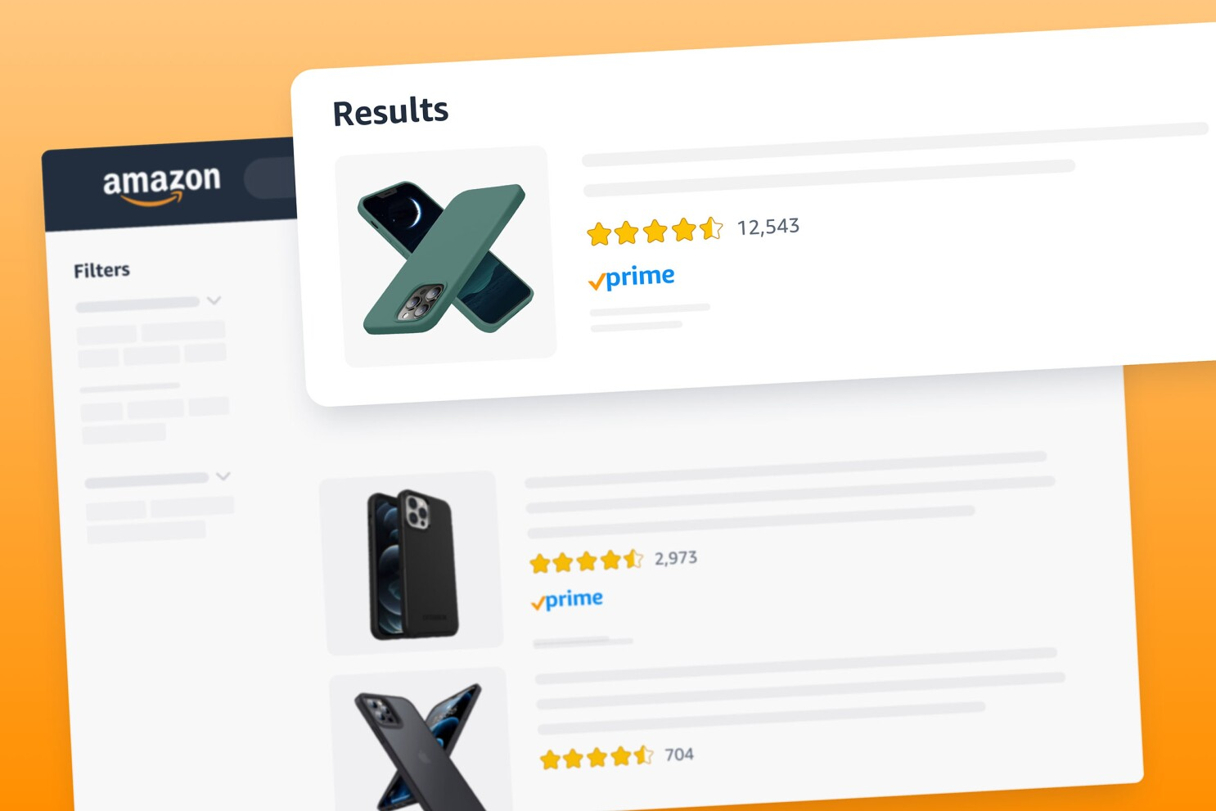
Key Features :-
Sales and Profit KPIs :- A snapshot of key performance indicators.
Category Drill-Down :- Detailed analysis of different product categories.
Regional and State-Wise Breakdown :- Performance metrics by region and state.
Monthly Insights :- Analysis of sales and profit trends month by month for each year.
PDF Download :- Easy sharing of the dashboard insights.

Slide 3
Objectives :-
To showcase a dynamic visualization of Amazon sales and profit KPIs.
To provide detailed insights broken down category-wise, state-wise, region-wise, and month-wise for each year.
Tools Used :- Tableau

Slide 4
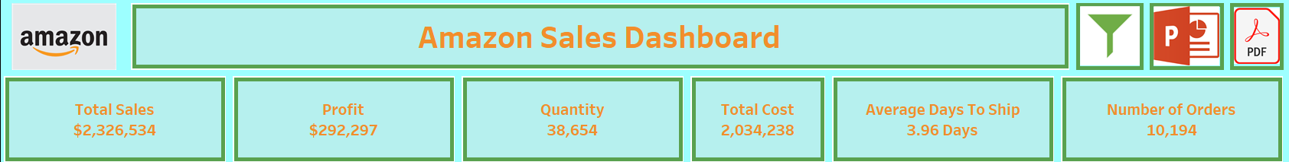
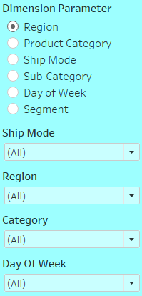
Insights :-
Sales and Profit KPIs And Filter
Overview of how the KPIs provide a quick summary of overall performance.
I have conducted an analysis on Amazon data using Tableau. In the filter section, I incorporated several dimension parameters, including region, product category, ship mode, subcategory, day of the week, and segment. Specifically, I focused on filtering by ship mode, region, category, and day of the week.

Slide 5
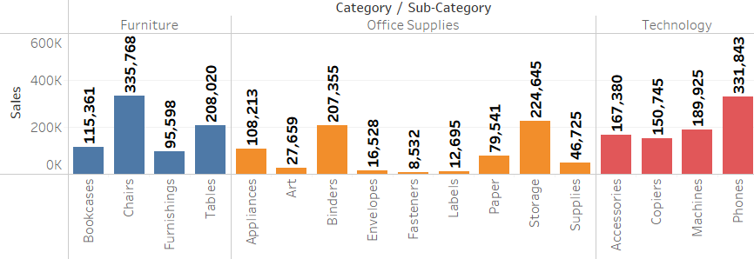
Insights :-
Category Drill-Down
Explanation of how users can drill down into specific categories to get more detailed information.

Slide 6
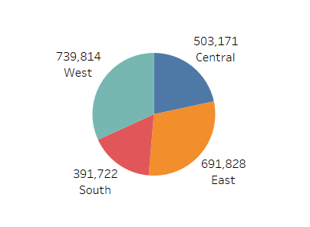
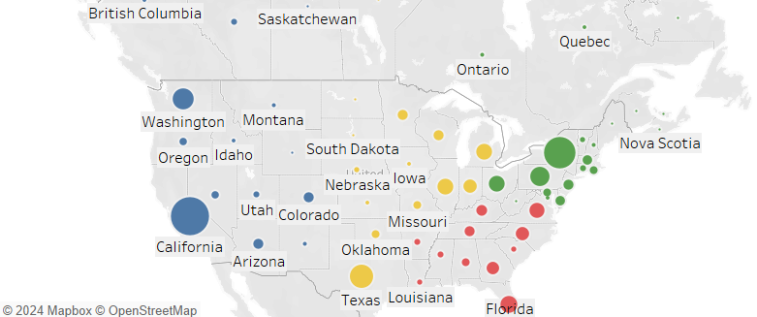
Insights :-
Regional and State-Wise Performance
Highlights of how the dashboard breaks down performance metrics by geography.

Slide 7
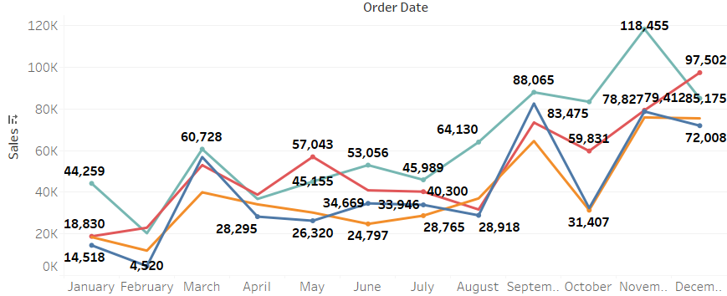
Insights :-
Monthly Insights
Detailed view of sales and profit trends for each month across different years.

Slide 8
Conclusion :-
The project demonstrates the capability to transform raw data into meaningful insights using Tableau.
The dashboard allows for comprehensive analysis, helping to uncover patterns and trends in Amazon sales data.

Slide 9
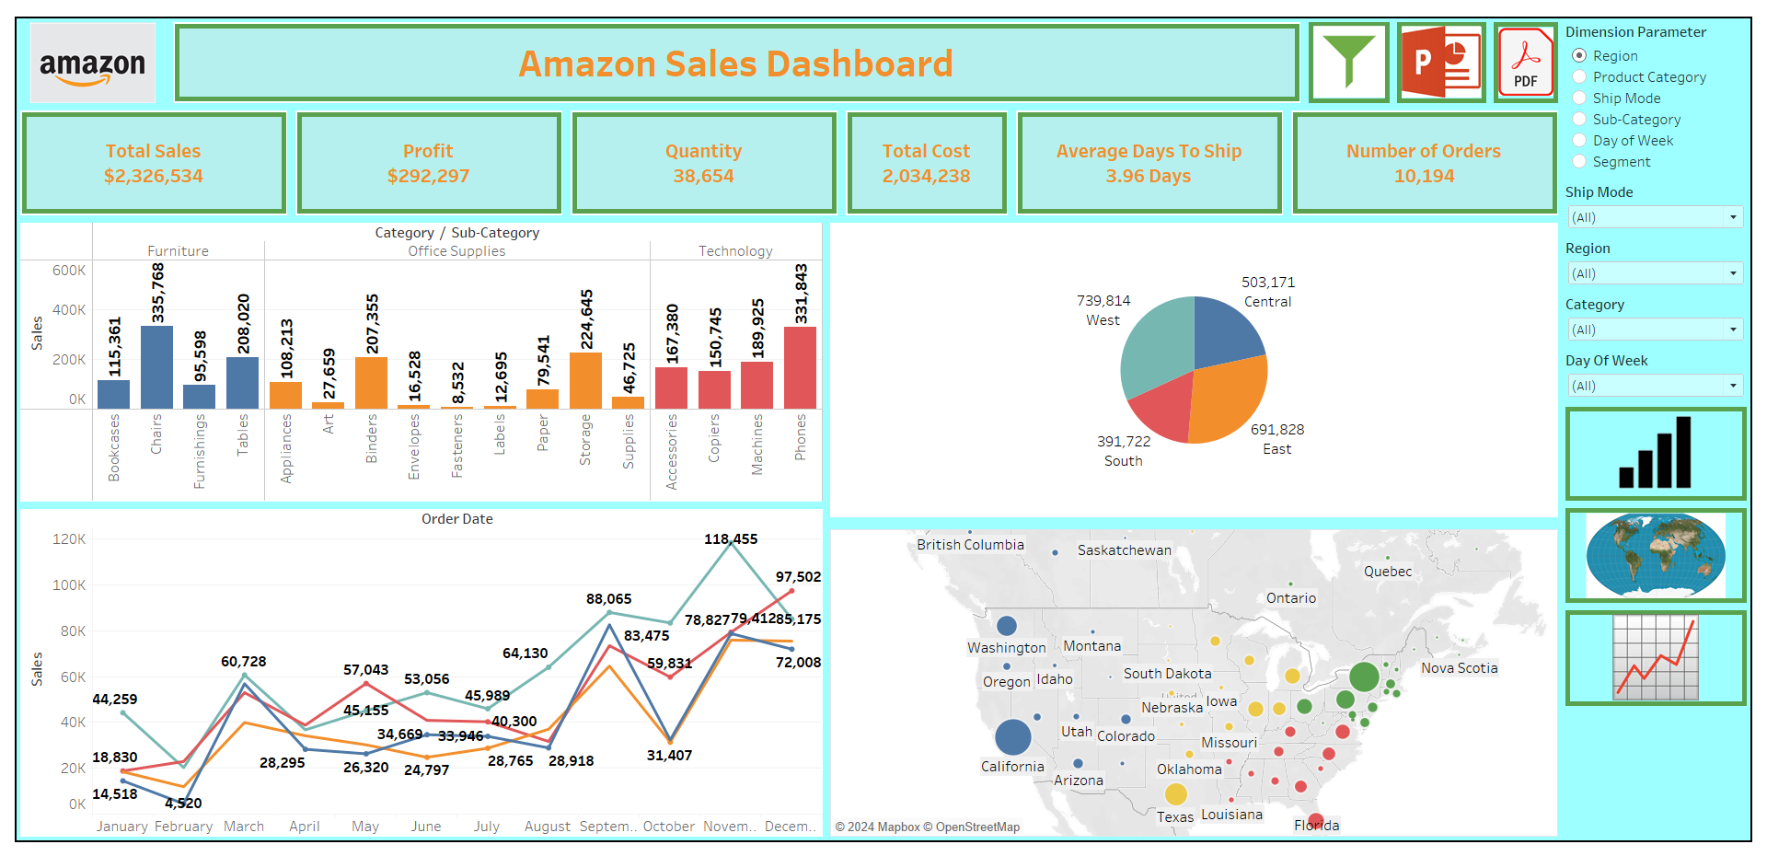
Dashboard

Slide 10
THANK YOU

